Slide 1
Title of Paper
Reading Wikipedia to Answer Open-Domain Questions
（阅读维基百科回答开放领域问题 ACL 2017）
汇报人：周星辰

Slide 2
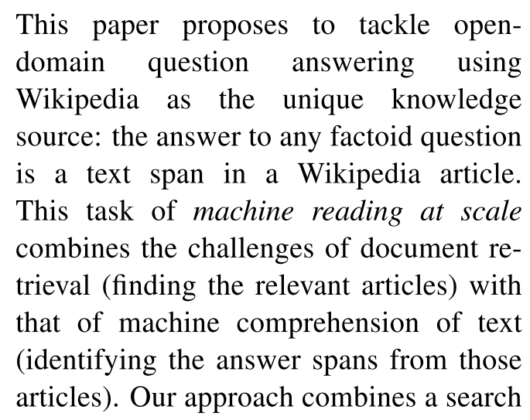
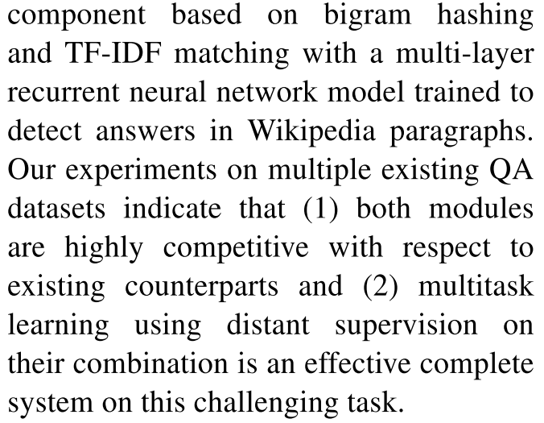
0. Abstract
The authors approach combines a search component based on bigram hashing and TF-IDF matching with a multi-layer recurrent neural network model trained to detect answers in Wikipedia paragraphs.

Slide 3
1. Introduction
This paper considers the problem of answering factoid questions in an open-domain setting using Wikipedia as the unique knowledge source, such as one does when looking for answers in an encyclopedia.
Knowledge Base
Easier for computers to process but too sparsely populated for open-domain QA.
Example: Freebase、DB-Pedia
Wikipedia
Contains up-to-date knowledge that humans are interested in. But it is designed for humans to read,
not machines.

Slide 4
1. Introduction
In order to answer any question, one must first retrieve the few relevant articles among more than 5 million items, and then scan them carefully to identify the answer.
This is called as machine reading at scale (MRS).
Large-scale QA systems
These machine comprehension resources assume that a short relevant text is already identified and given to the model, which is not realistic for open-domain QA system.
Example: IBM’s DeepQA、SQuAD、CNN/Daily Mail、CBT
QA with MRS
Focus on simultaneously maintaining the challenge of machine comprehension, which requires the deep understanding of text, while keeping the realistic constraint of searching over a large open resource.

Slide 5
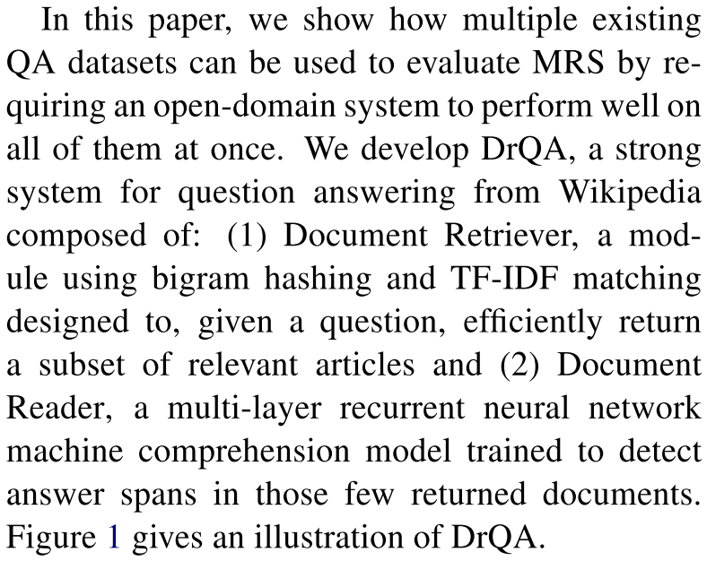
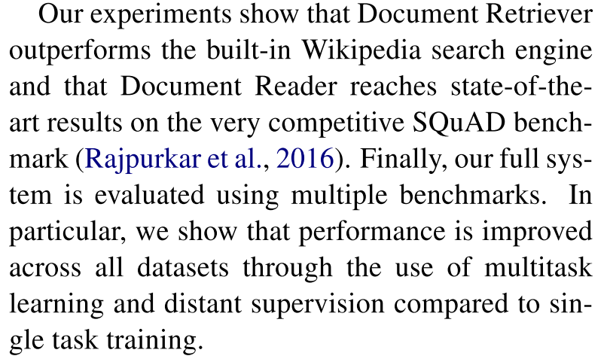
1. Introduction
The authors user multiple existing QA datasets to evaluate MRS.
They also develop DrQA, which composed of Document Retriever and Document Reader.

Slide 6
2. Related Work
Related work of Open-domain QA、 Machine comprehension of text、 QA using Wikipedia and Multitask learning. In this paper, the authors combine these methods to realize DrQA system.
Open-domain QA
Many innovations have occurred in context of KBQA. However, KBs have limitations (incompleteness, fixed schemas) .
Example: WebQuestions、SimpleQuestions、OpenIE
Machine comprehension of text
That subfield has made considerable progress recently thanks to new deep learning architectures.
Example: attention-based、memory-augmented nn、QuizBowl、CNN/Daily Mail、CBT、SQuAD
QA using Wikipedia
QA using Wikipedia as a resource has been explored previously.
Example: AskMSR、DeepQA、YodaQA
Multitask learning on QA
Example： Bordes et al. (2015) combined WebQuestions and SimpleQuestions using distant supervision with Freebase as the KB to give slight improvements on both datasets.

Slide 7
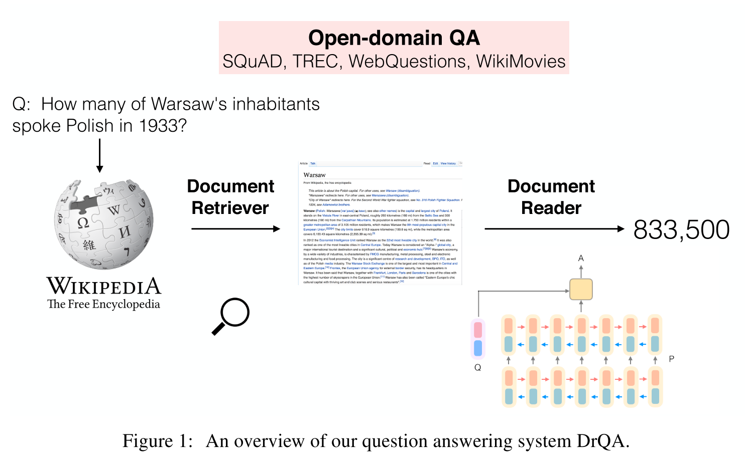
3. Our System: DrQA
DrQA for MRS, which consists of two components:

Slide 8
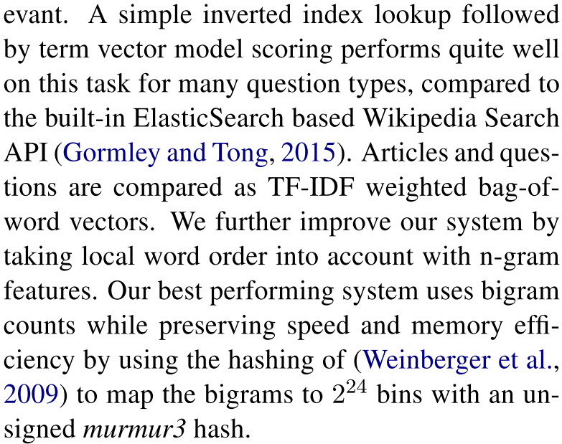
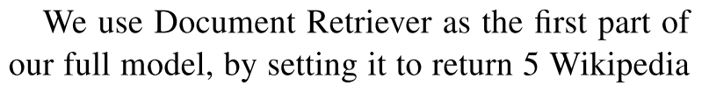
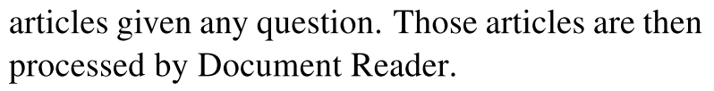
3. Our System: DrQA
Document Retriever: Following classical QA systems, the authors use an efficient (non-machine learning) document retrieval system to first narrow their search space and focus on reading only articles that are likely to be relevant.

Slide 9
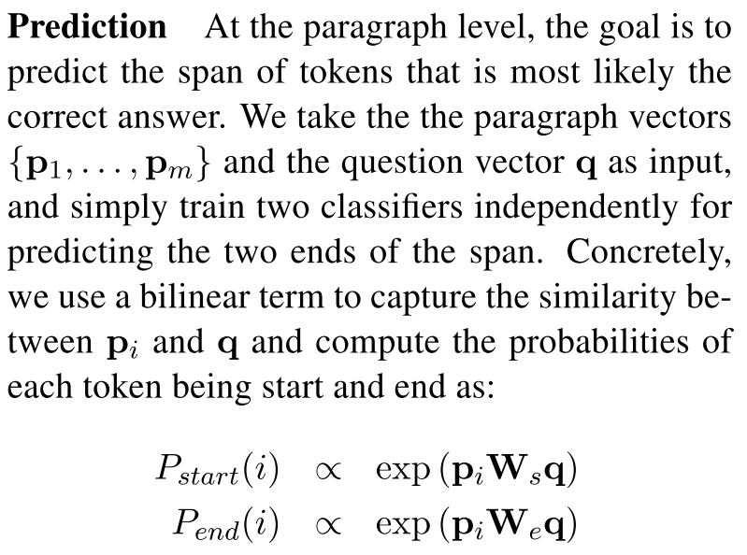
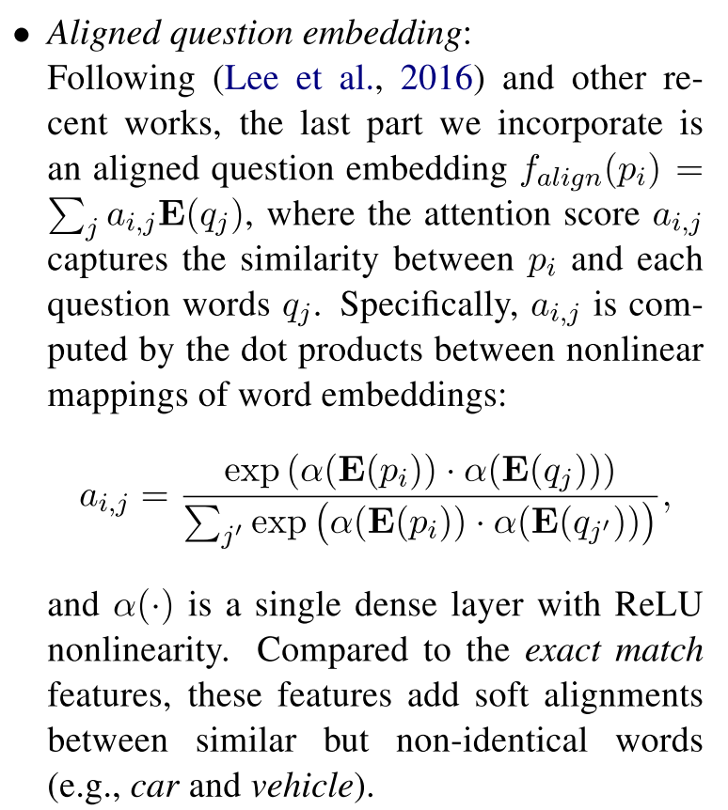
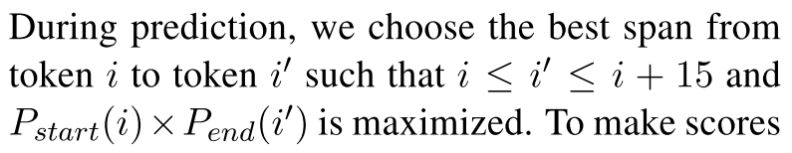
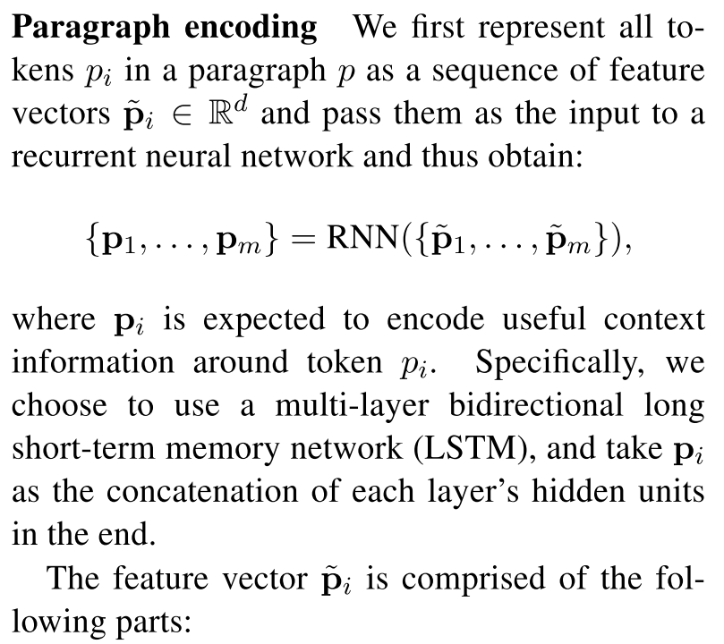
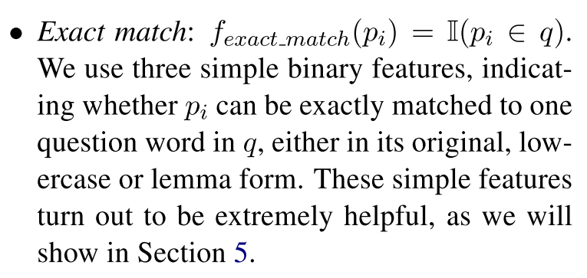
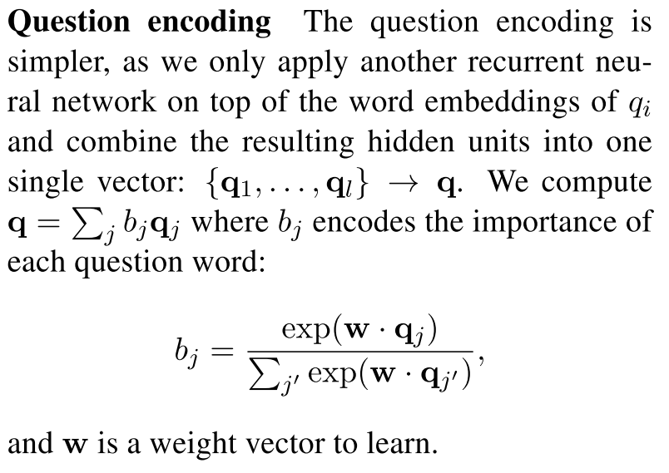
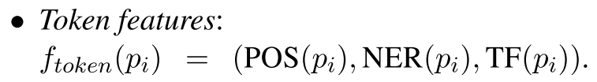
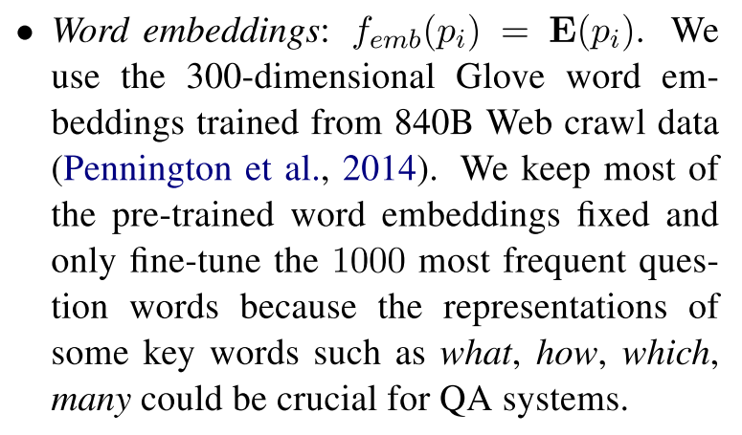
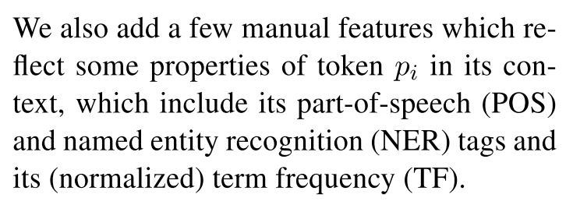
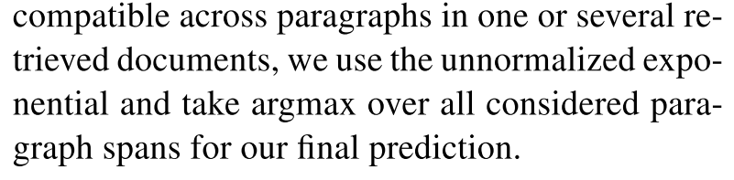
3. Our System: DrQA
Document Reader: The authors develop an RNN model that apply to each paragraph in turn and finally aggregate the predicted answers.
Including Paragraph encoding、Question encoding and Prediction.

Slide 10
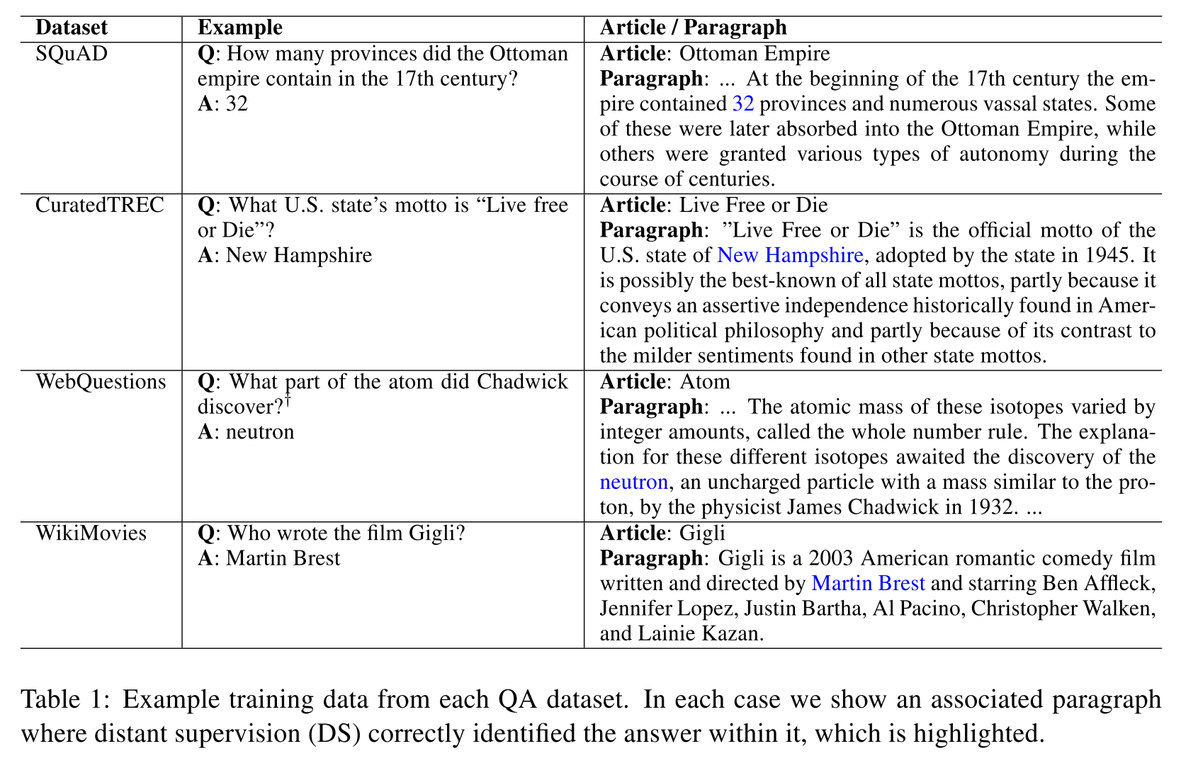
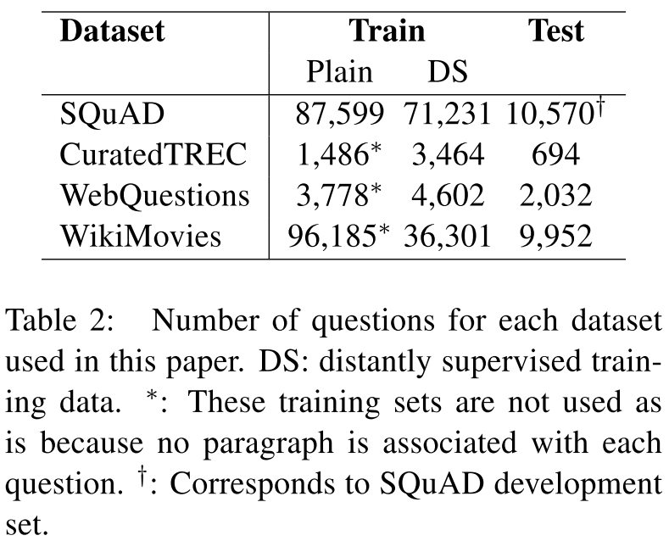
4. Data
The work relies on three types of data: Wikipedia as knowledge source for finding answers、SQuAD to train Document Reader and three more QA datasets(CuratedTREC、WebQuestions and WikiMovies) to test open-domain QA abilities and to evaluate learn from multitask learning and distant supervision abilities.

Slide 11
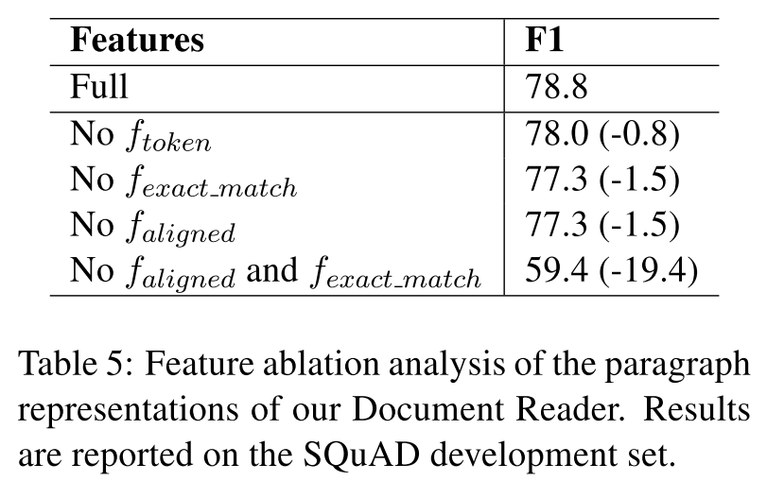
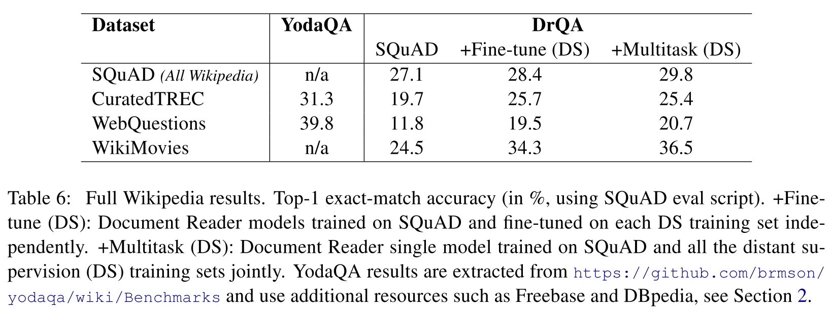
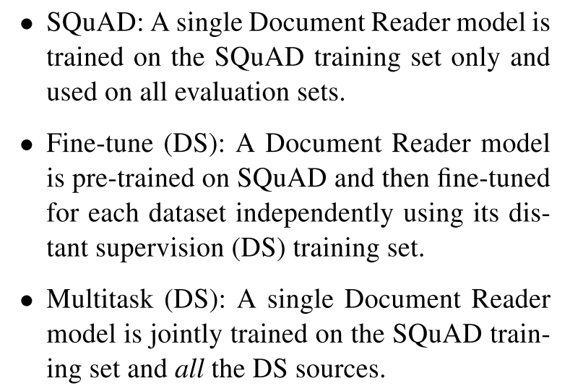
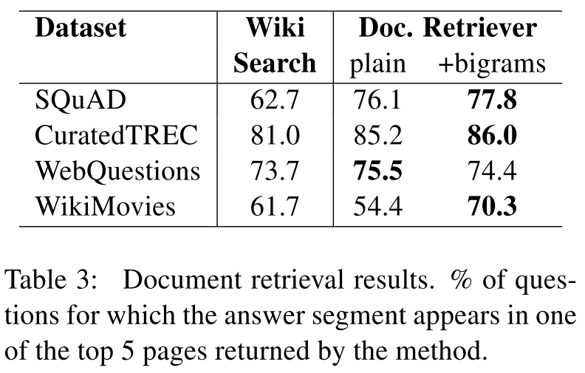
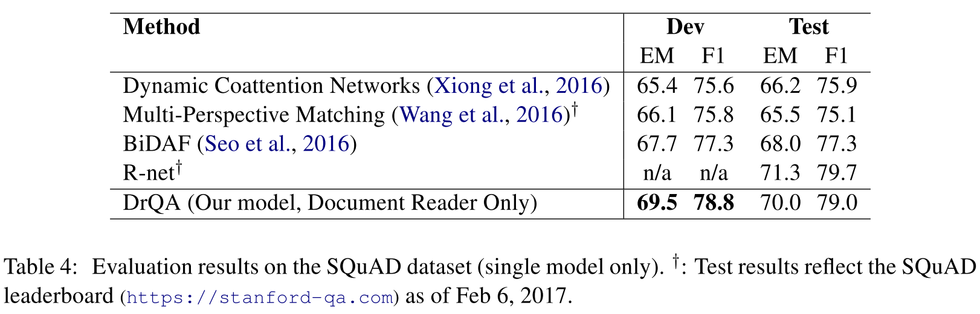
5. Experiments
Experiments include: Finding Relevant Articles、Reader Evaluation on SQuAD、Full Wikipedia Question Answering.

Slide 12
6. Conclusion
The authors studied the task of machine reading at scale. The result indicate that MRS is a key challenging task. Machine comprehension systems alone cannot solve the overall task. The method integrates search, distant supervision, and multitask learning to provide an effective complete system. Evaluating the individual components as well as the full system across multiple benchmarks showed the efficacy of our approach.
Future work: (i) incorporate the fact that Document Reader aggregates over multiple paragraphs and documents directly in the training, as it currently trains on paragraphs independently.
(ii) perform endto-end training across the Document Retriever and Document Reader pipeline, rather than independent systems.

Slide 13
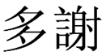
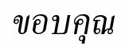
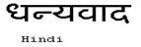
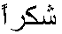

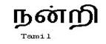
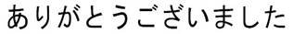
Hindi
Traditional Chinese
Thai
Thank You
Gracias
Russian
Spanish
Obrigado
English
Danke
Brazilian Portuguese
Arabic
Grazie
German
Italian
Merci
French
Simplified Chinese
Tamil
Korean
Japanese
Notes:
13

